Slide 1
Aerial Tramway
Group 14

Slide 2

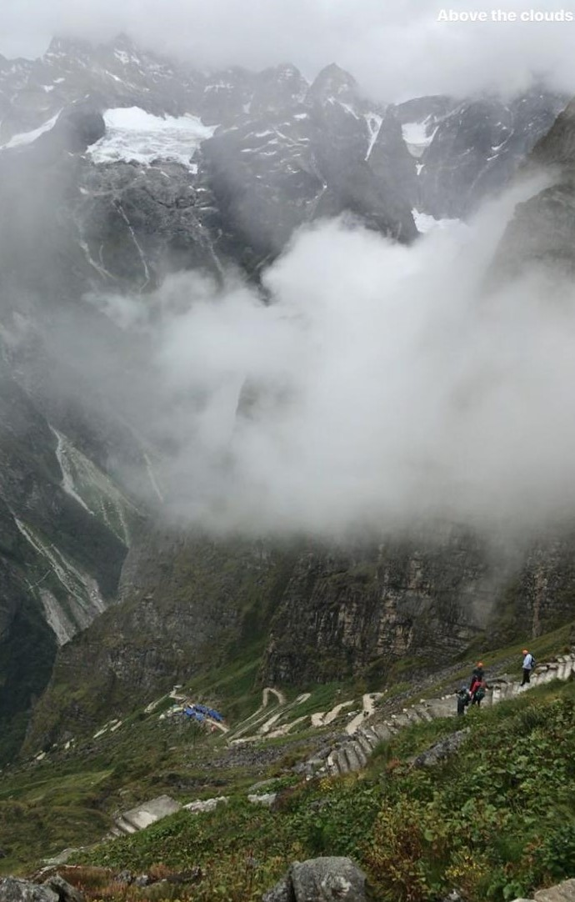

Identification of Need
Reaching the top of a hill has always been difficult, hasn’t it?
Well roadways did bring some comfort, saving us from getting exhausted. But, they have their own limitation and risks when it comes to driving in a very steep road. This is where an aerial tramway comes in, helping us travel large distances in hilly regions with ease.

Slide 3
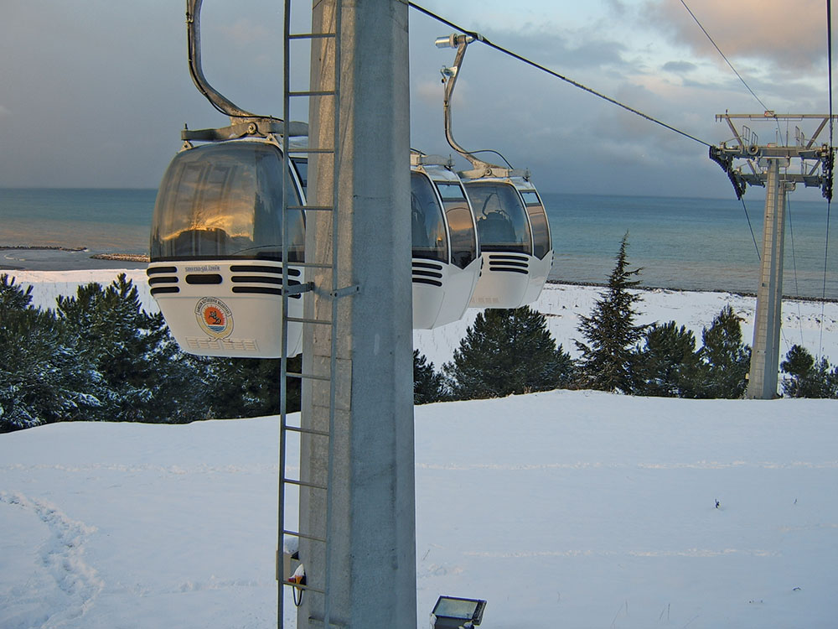
Definition of problem
The main concerns regarding the travel in an aerial tramway are:
the structure of the tramway to withstand.
it’s own weight and that of it’s passengers.
strength of the ropes holding the tramway.

Slide 4
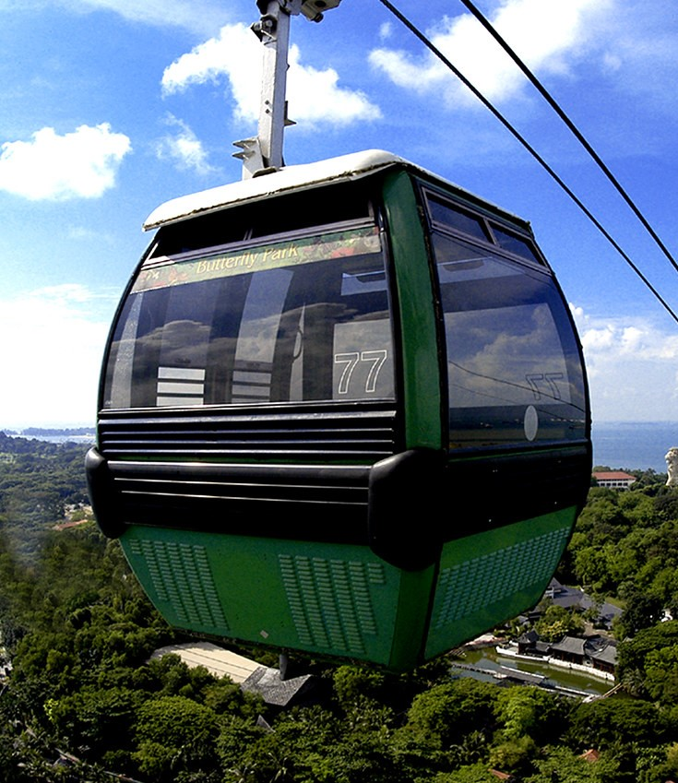
Definition of problem
Hence, our objective here shall be to minimize the issues caused by following the respective methods:
A compact tramway, light enough to be mobile
Strong enough to withstand working load and stresses
Putting up multiple checkpoints for the ropes

Slide 5

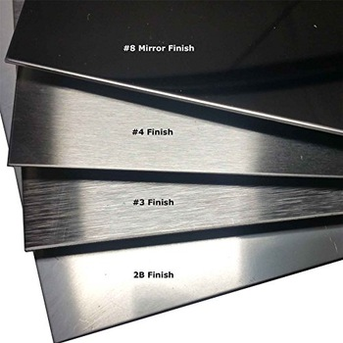
Synthesis of Scheme
FUNCTION:
MATERIAL:
The function of the tram is to pick up and drop i.e. to transport people or some calculated load from one checkpoint to another.
The material must be light and strong.

Slide 6
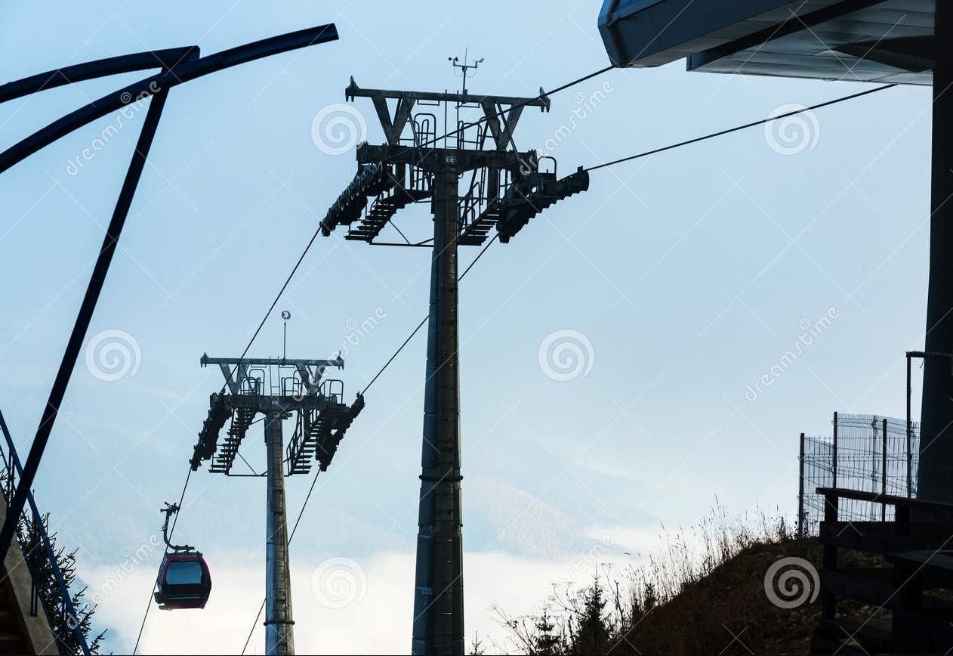
Synthesis of Scheme
CONSTRUCTION:
SAFETY:
We construct ample number of checkpoints to maintain proper efficiency of movement of the tram and avoid turbulence .
We ensure the factor of safety for the rope and the tram to be numerically greater than 10.

Slide 7
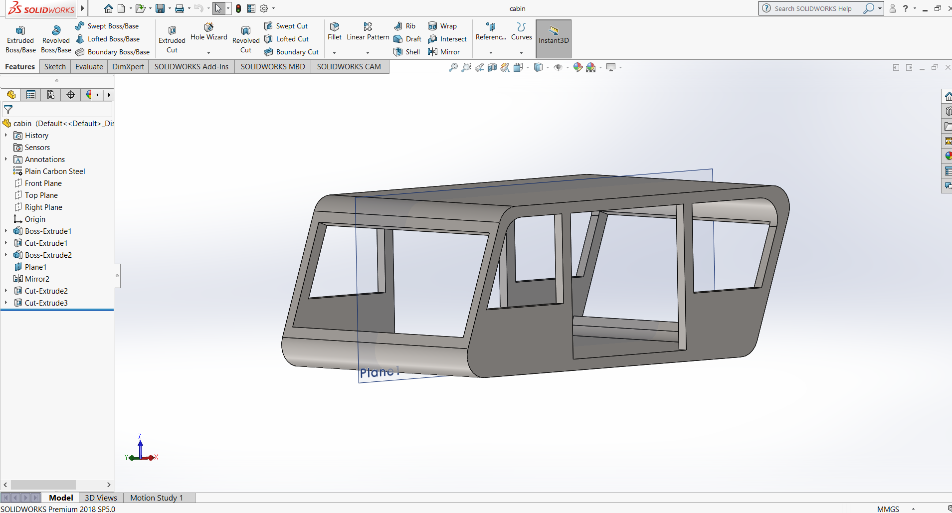

Slide 8
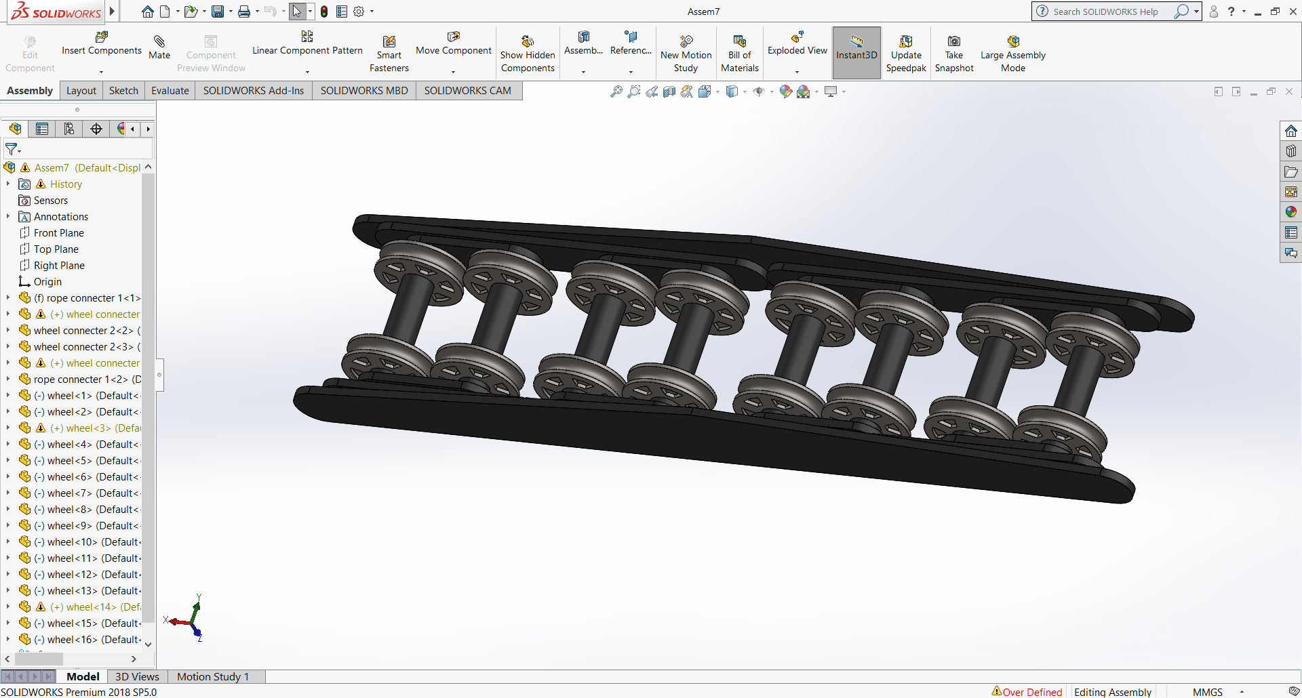

Slide 9
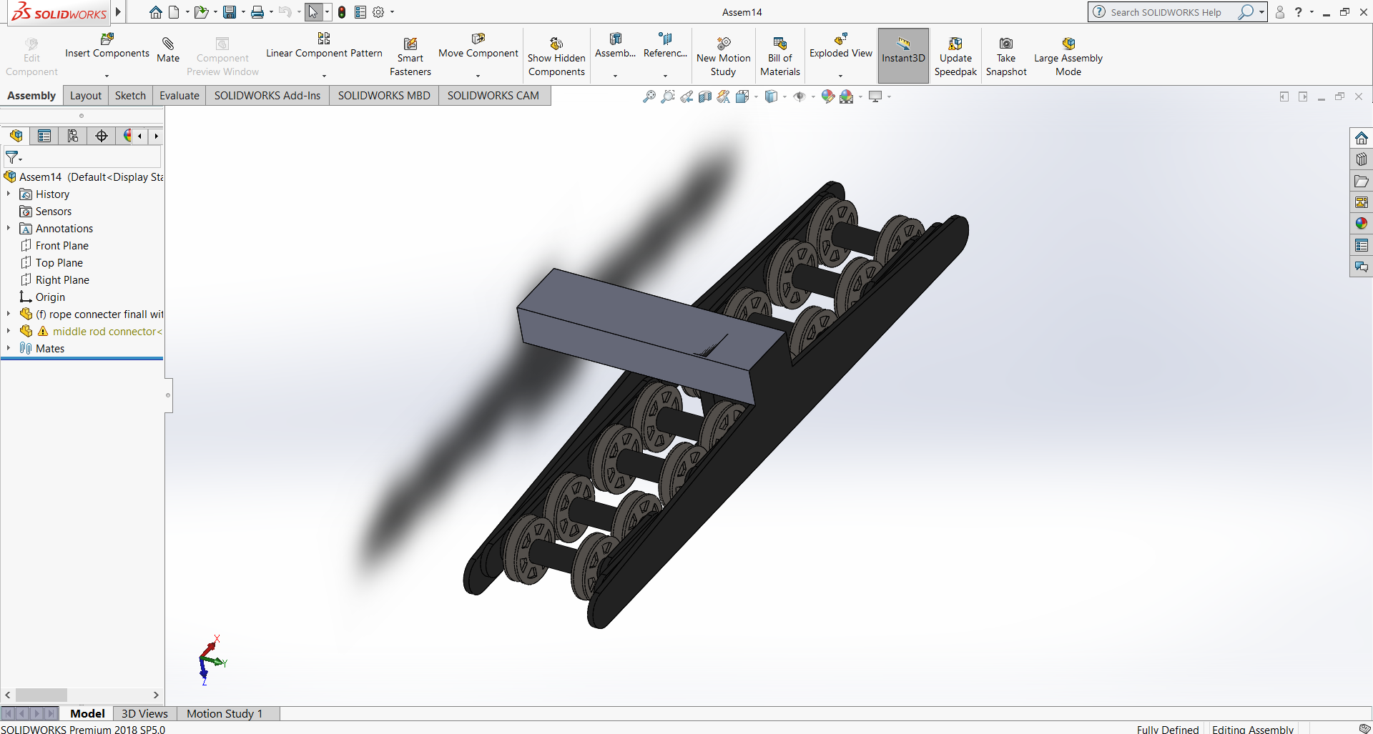

Slide 10
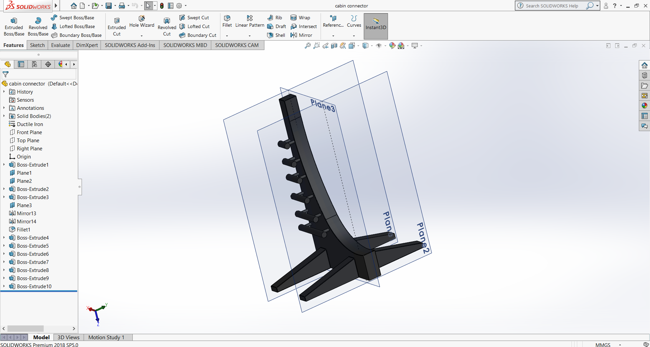

Slide 11
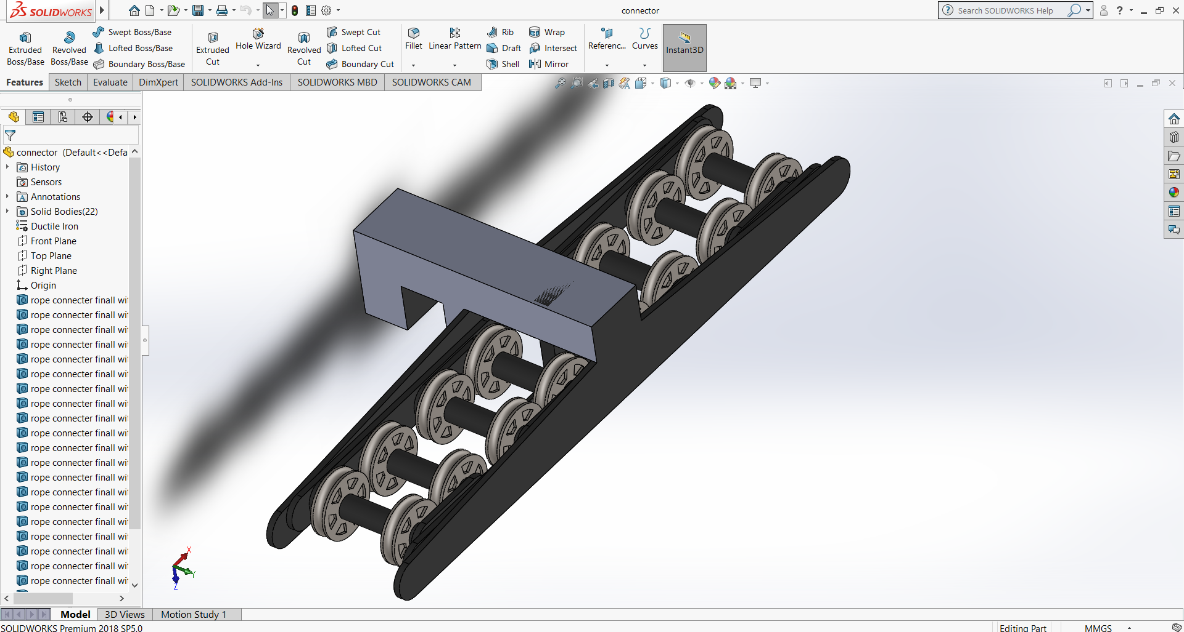

Slide 12
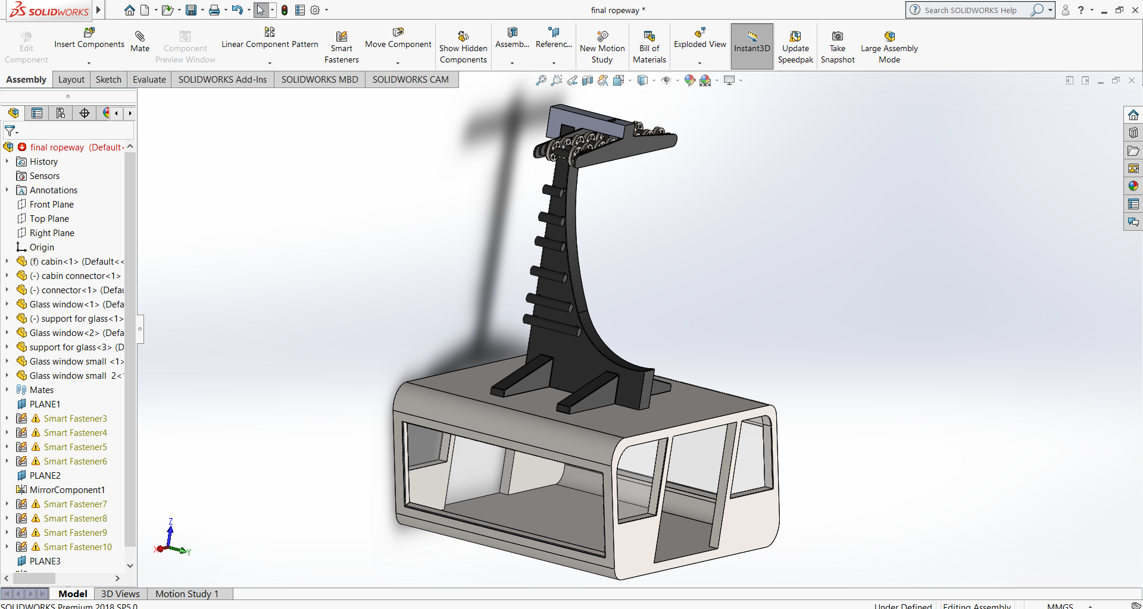

Slide 13
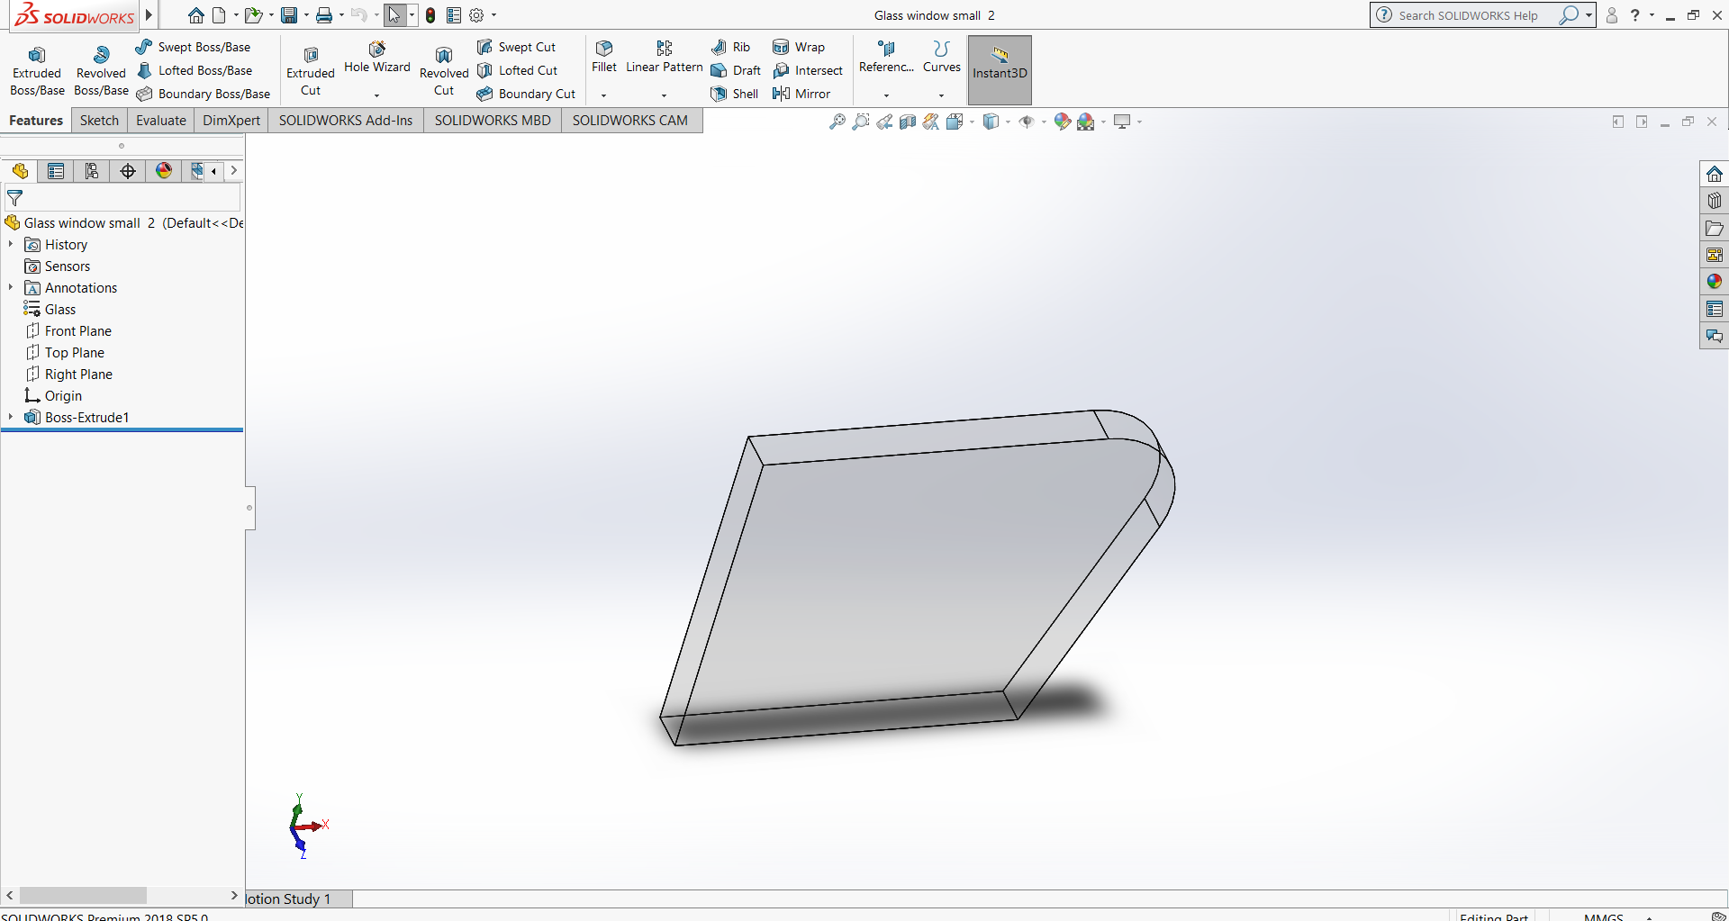

Slide 14
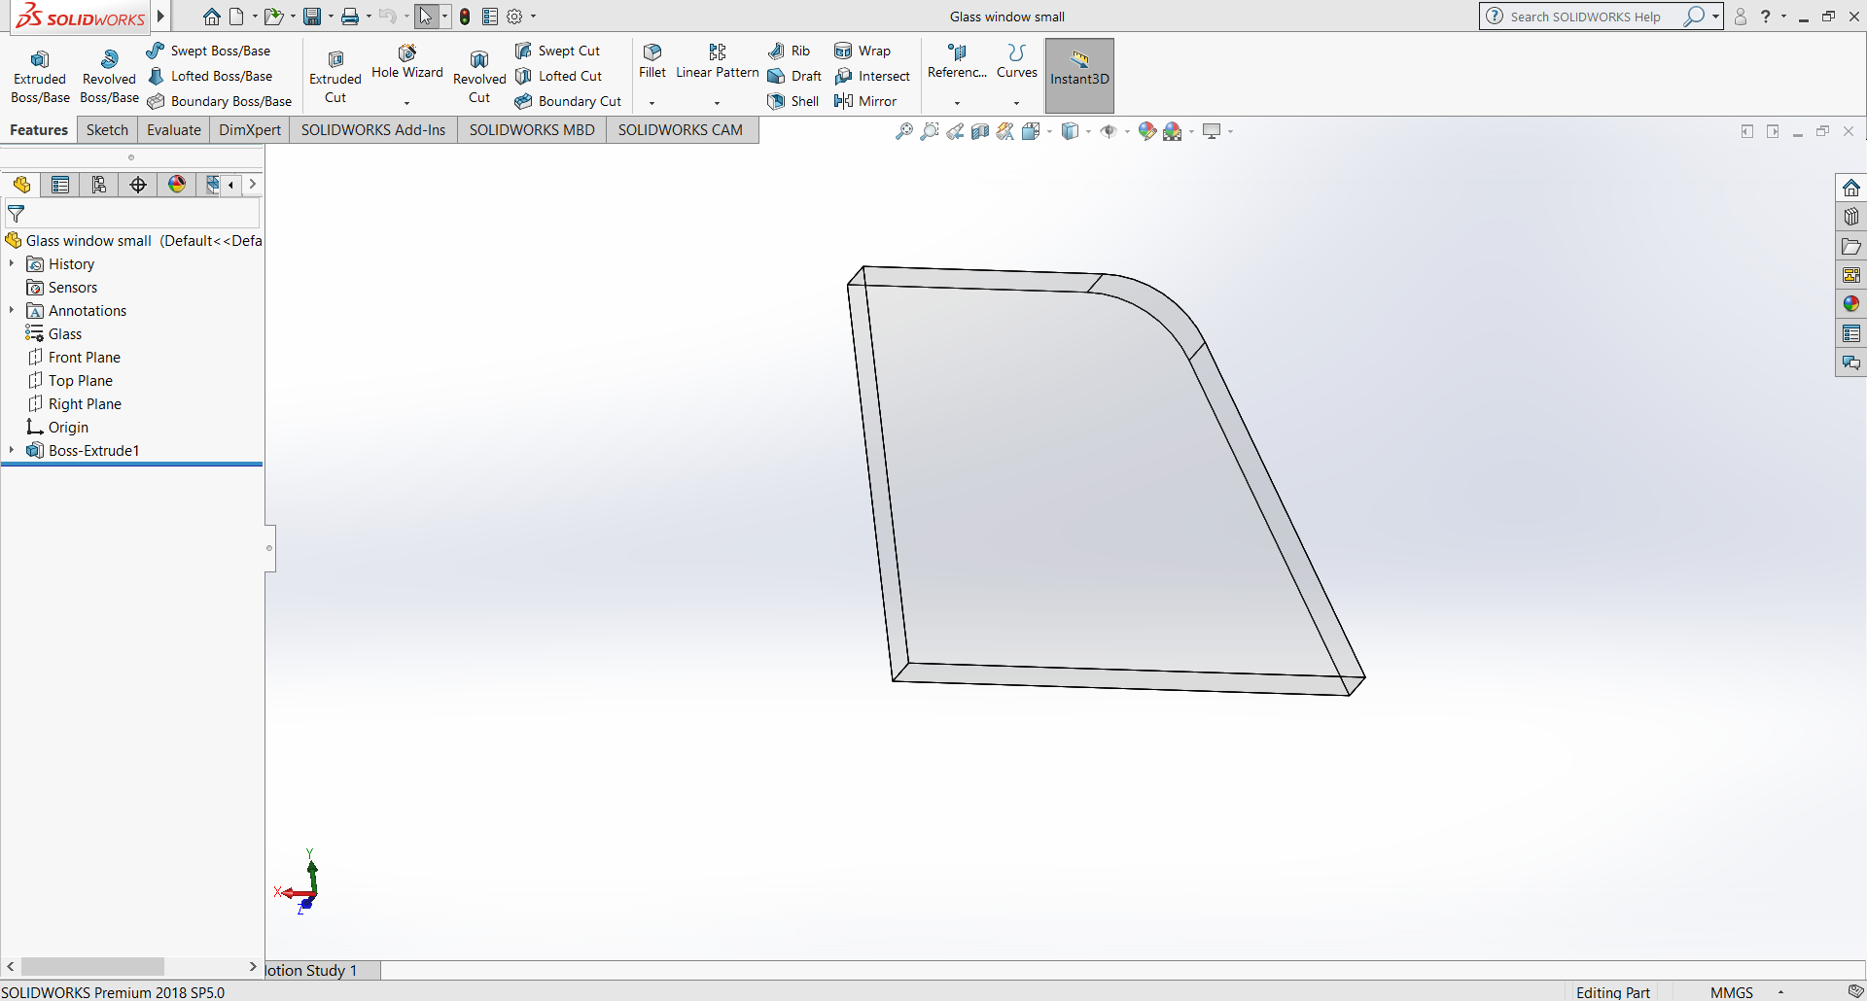

Slide 15
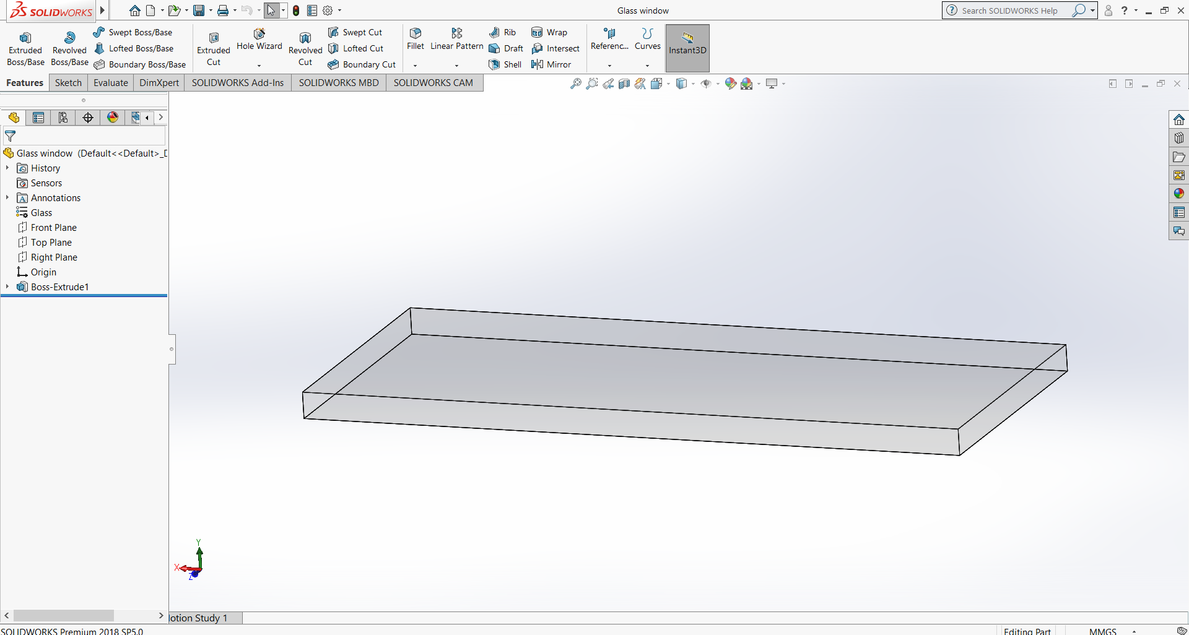

Slide 16
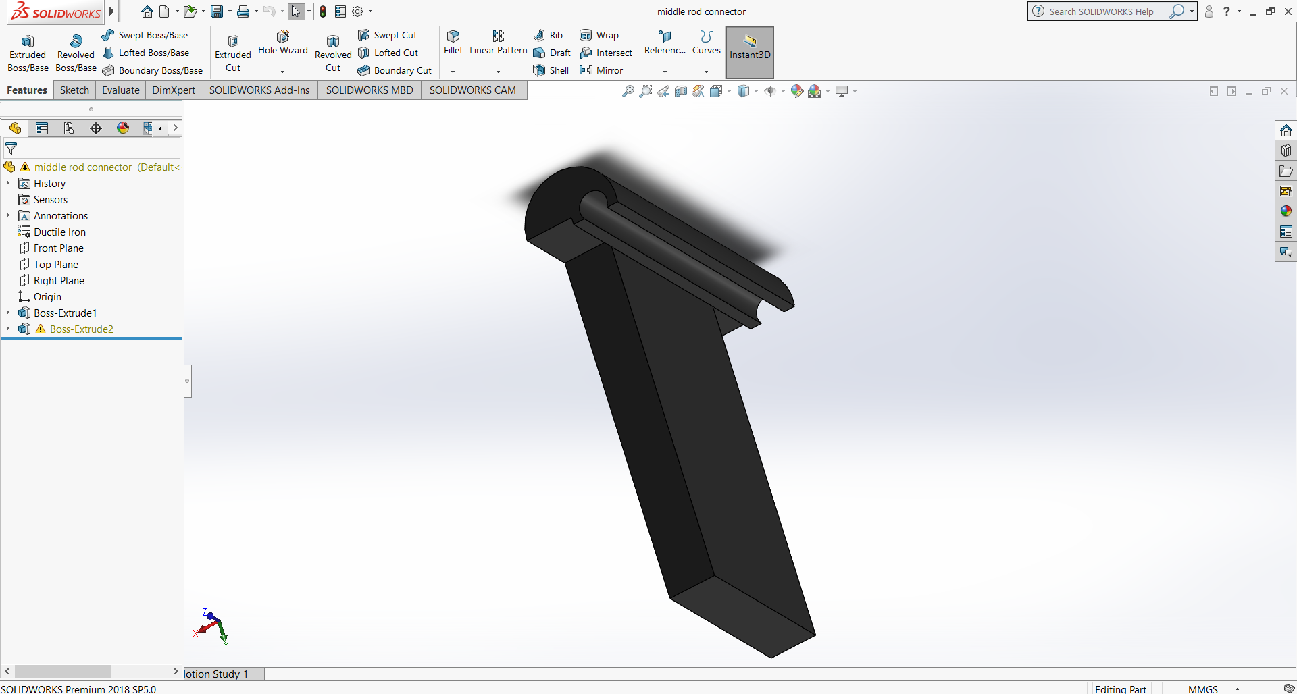

Slide 17
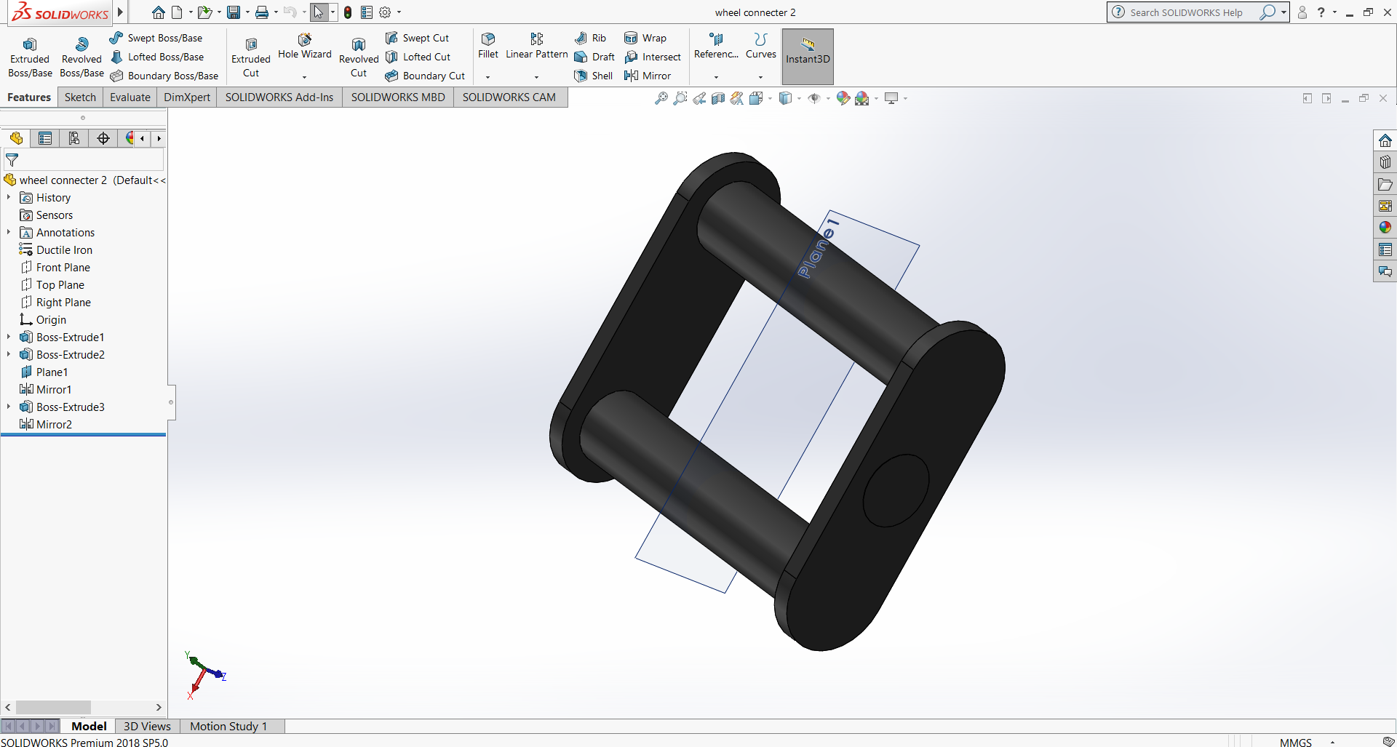

Slide 18
